Slide 1

Using Datalog with
Binary Decision Diagrams for Program Analysis
John Whaley, Dzintars Avots,
Michael Carbin, Monica S. Lam
Stanford University
November 5, 2005
Notes:
First of all, I want to thank you all for sticking around until the last talk. I’ll try my best to make it interesting.

Slide 2
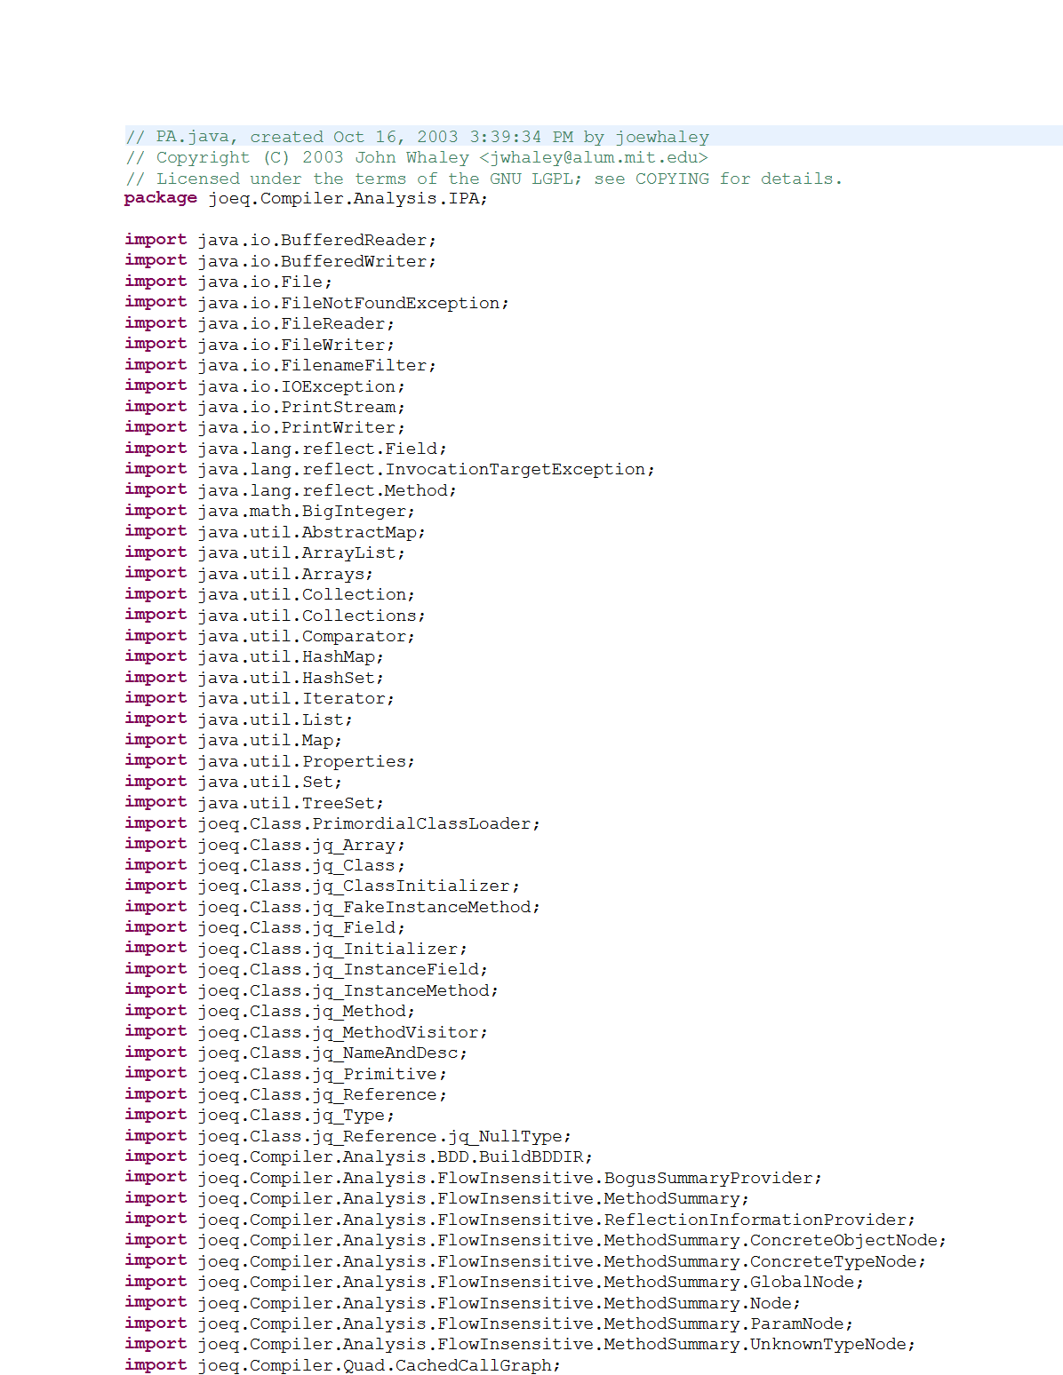
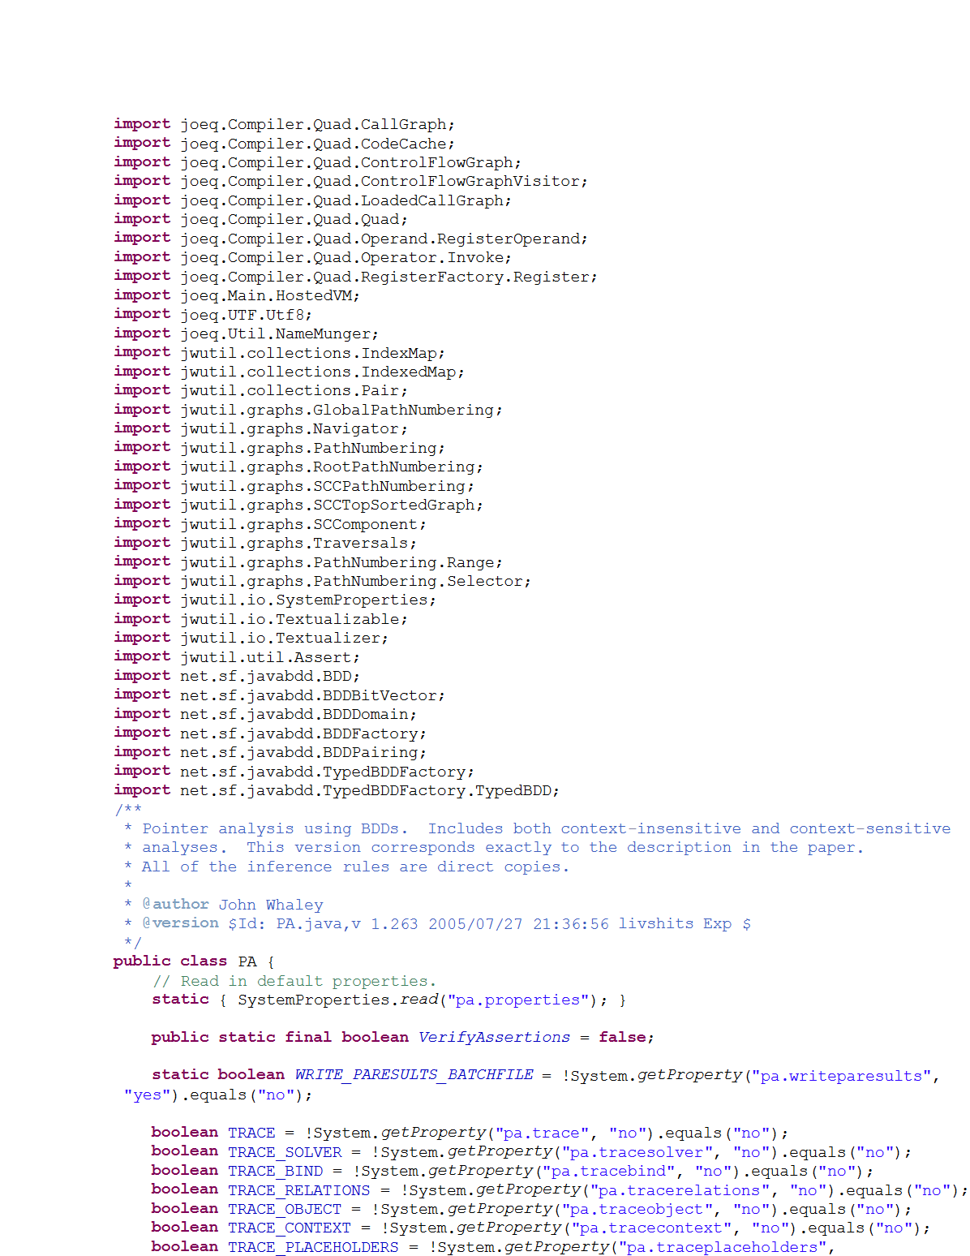
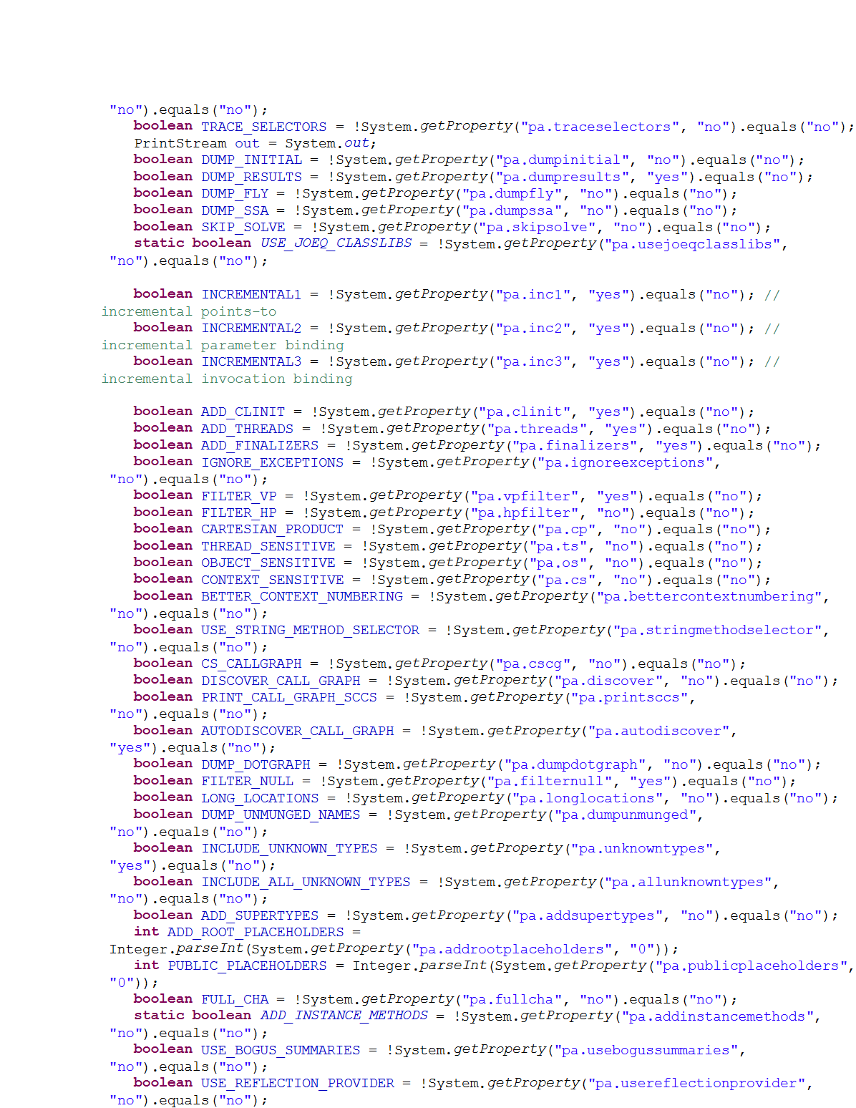
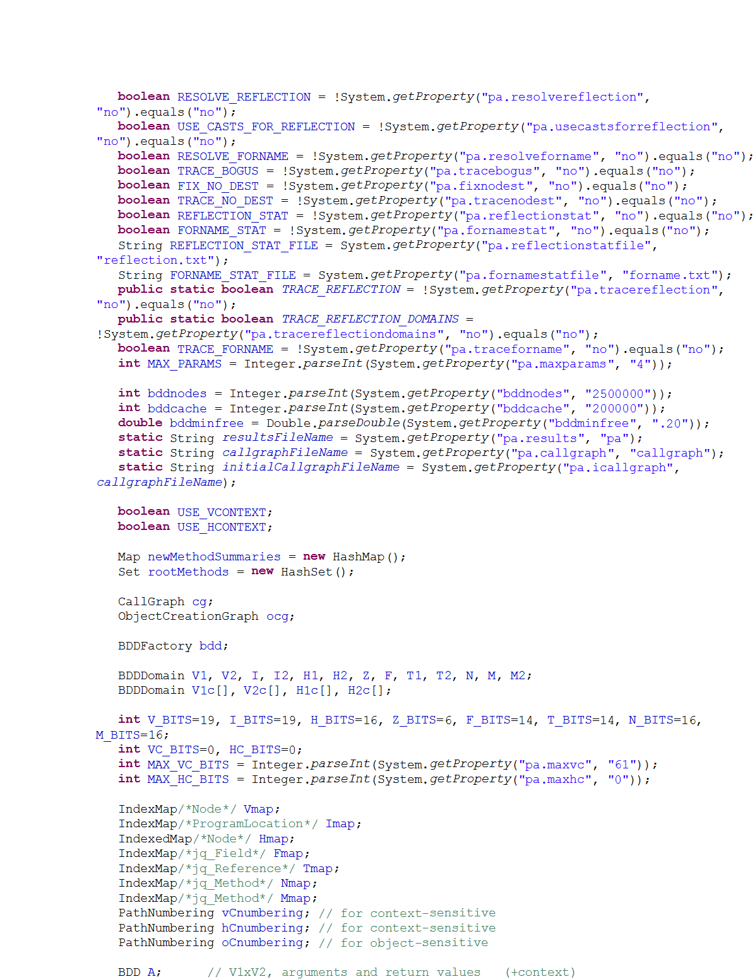
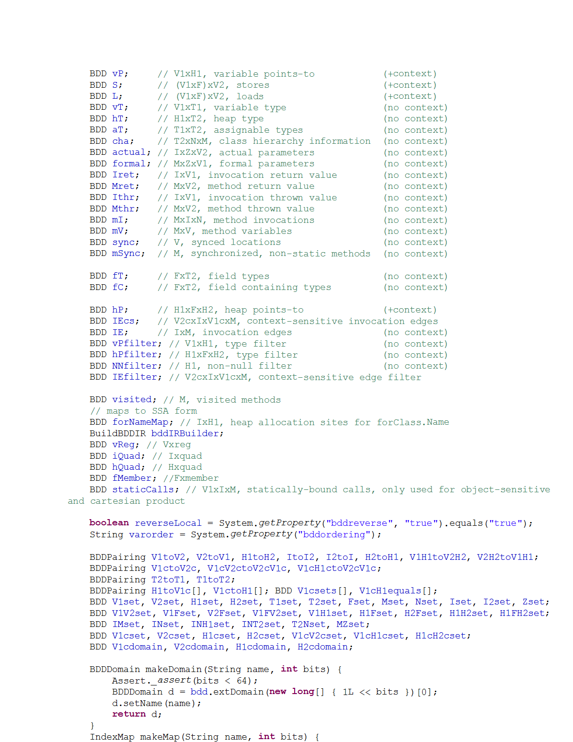
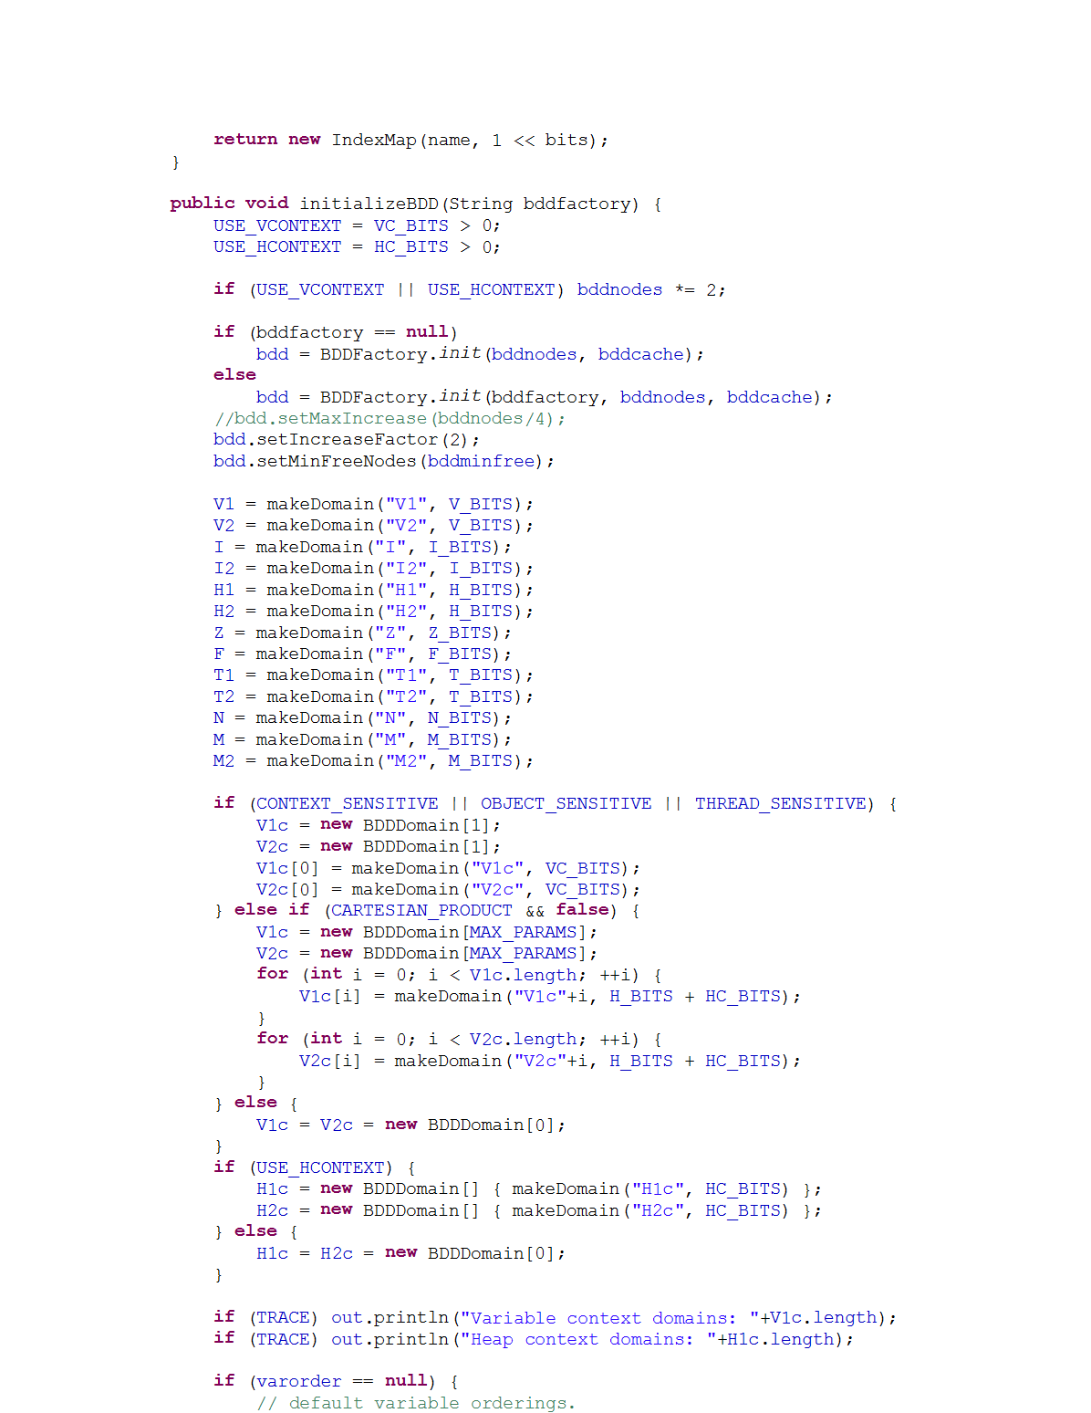
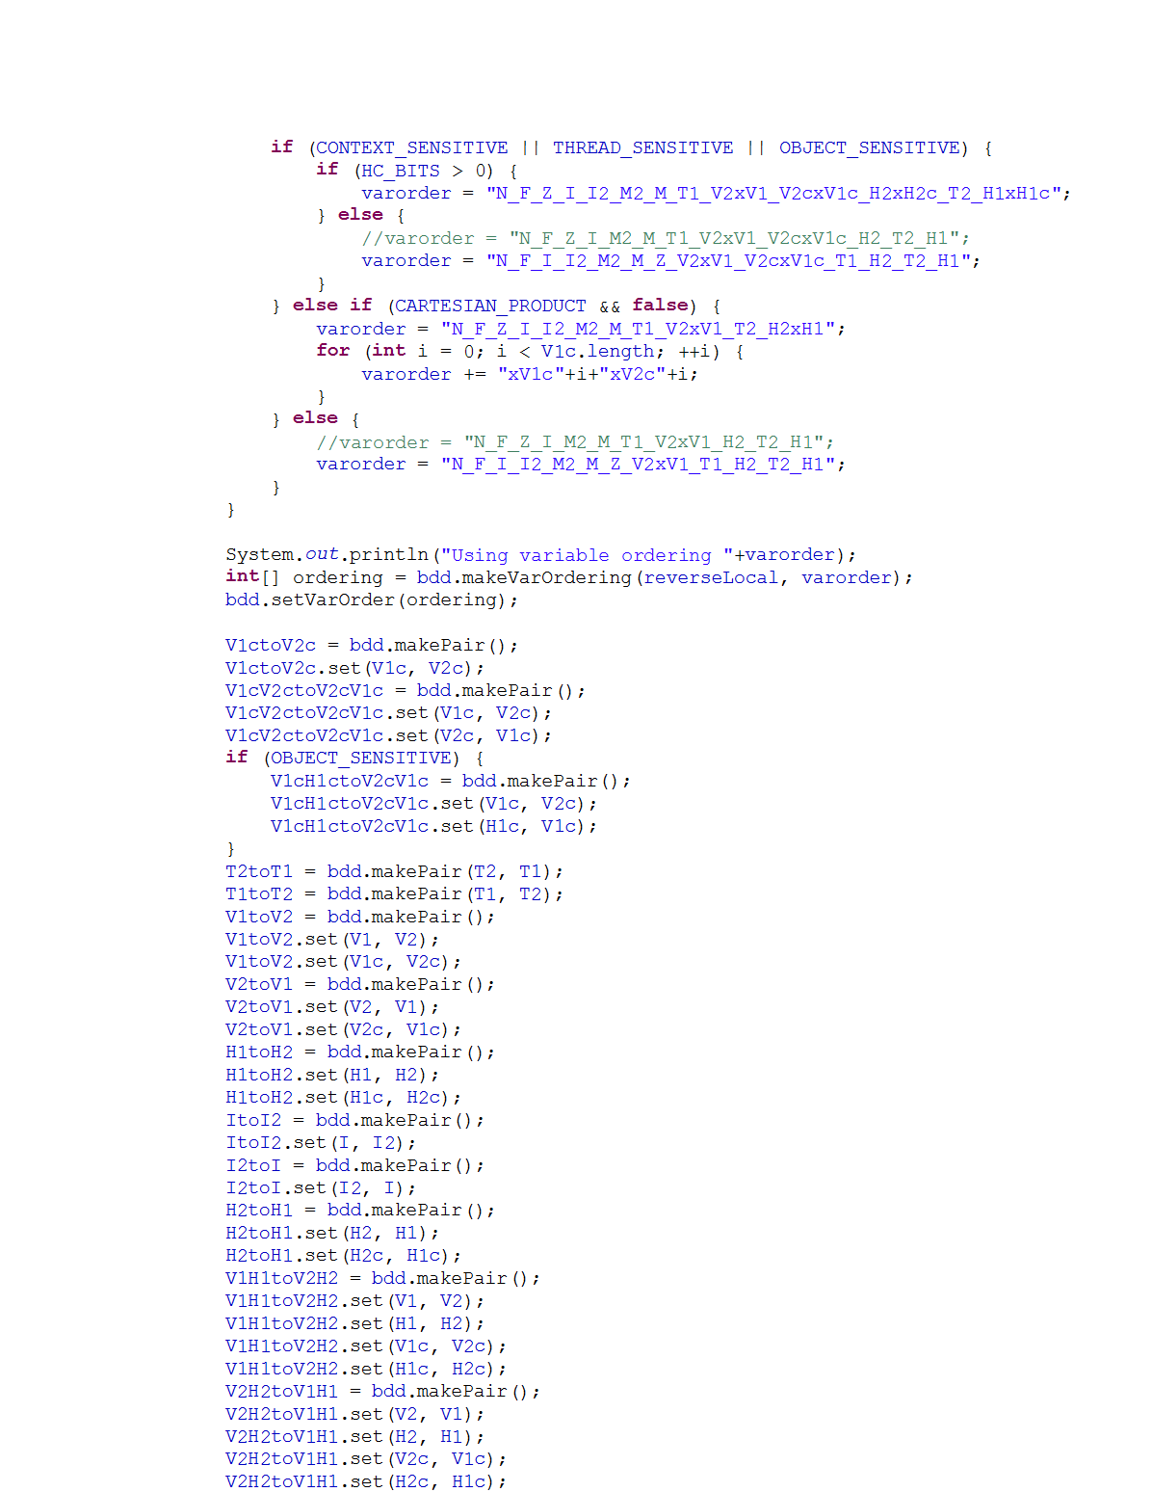
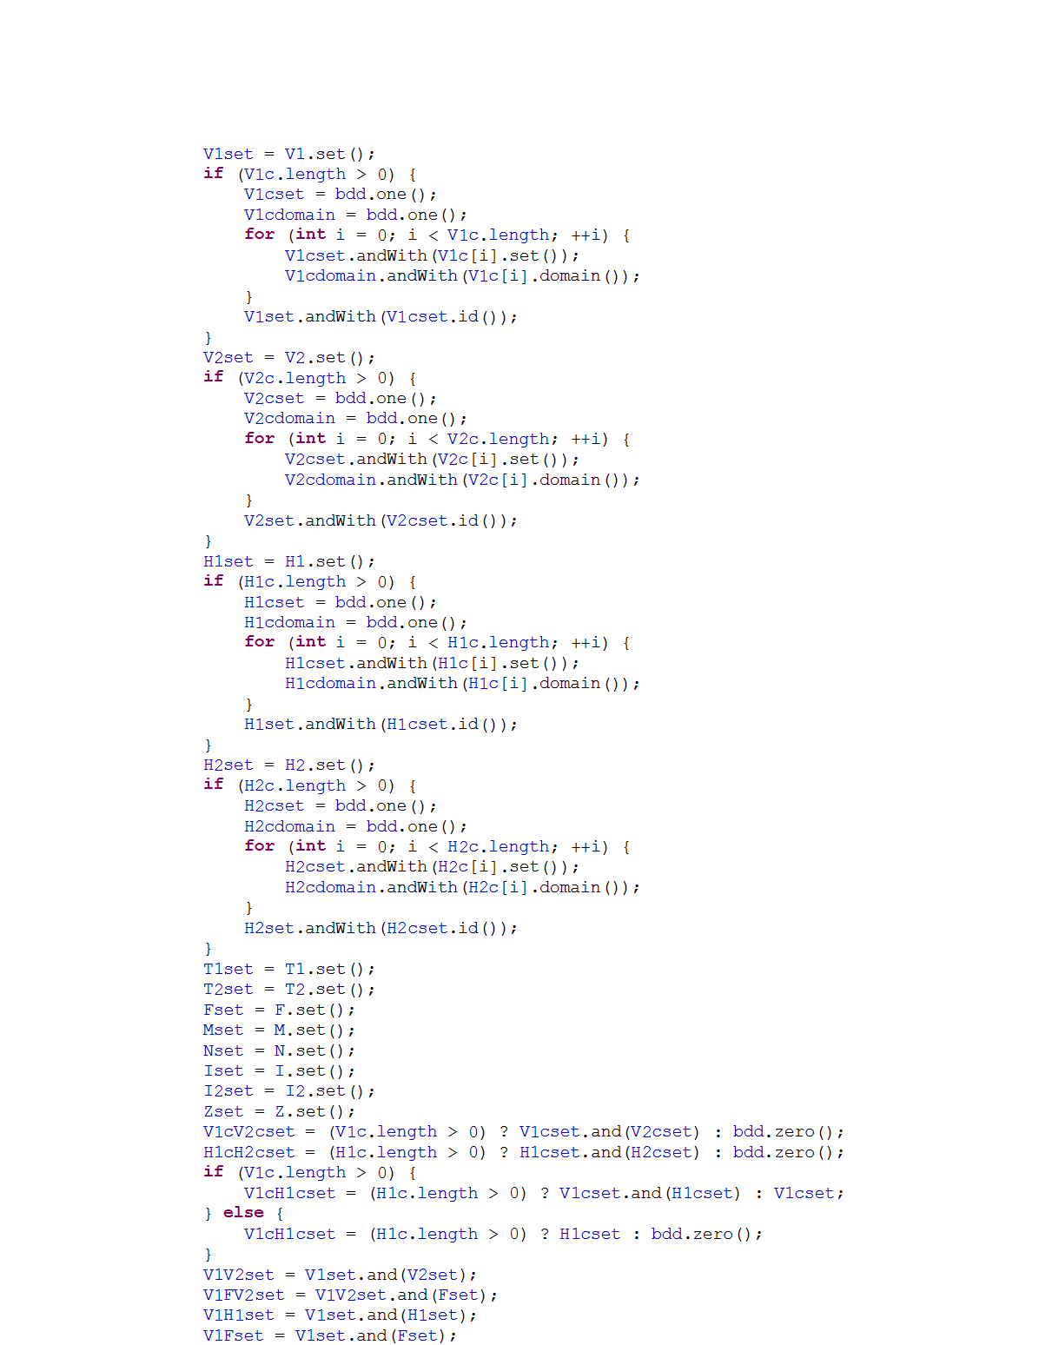
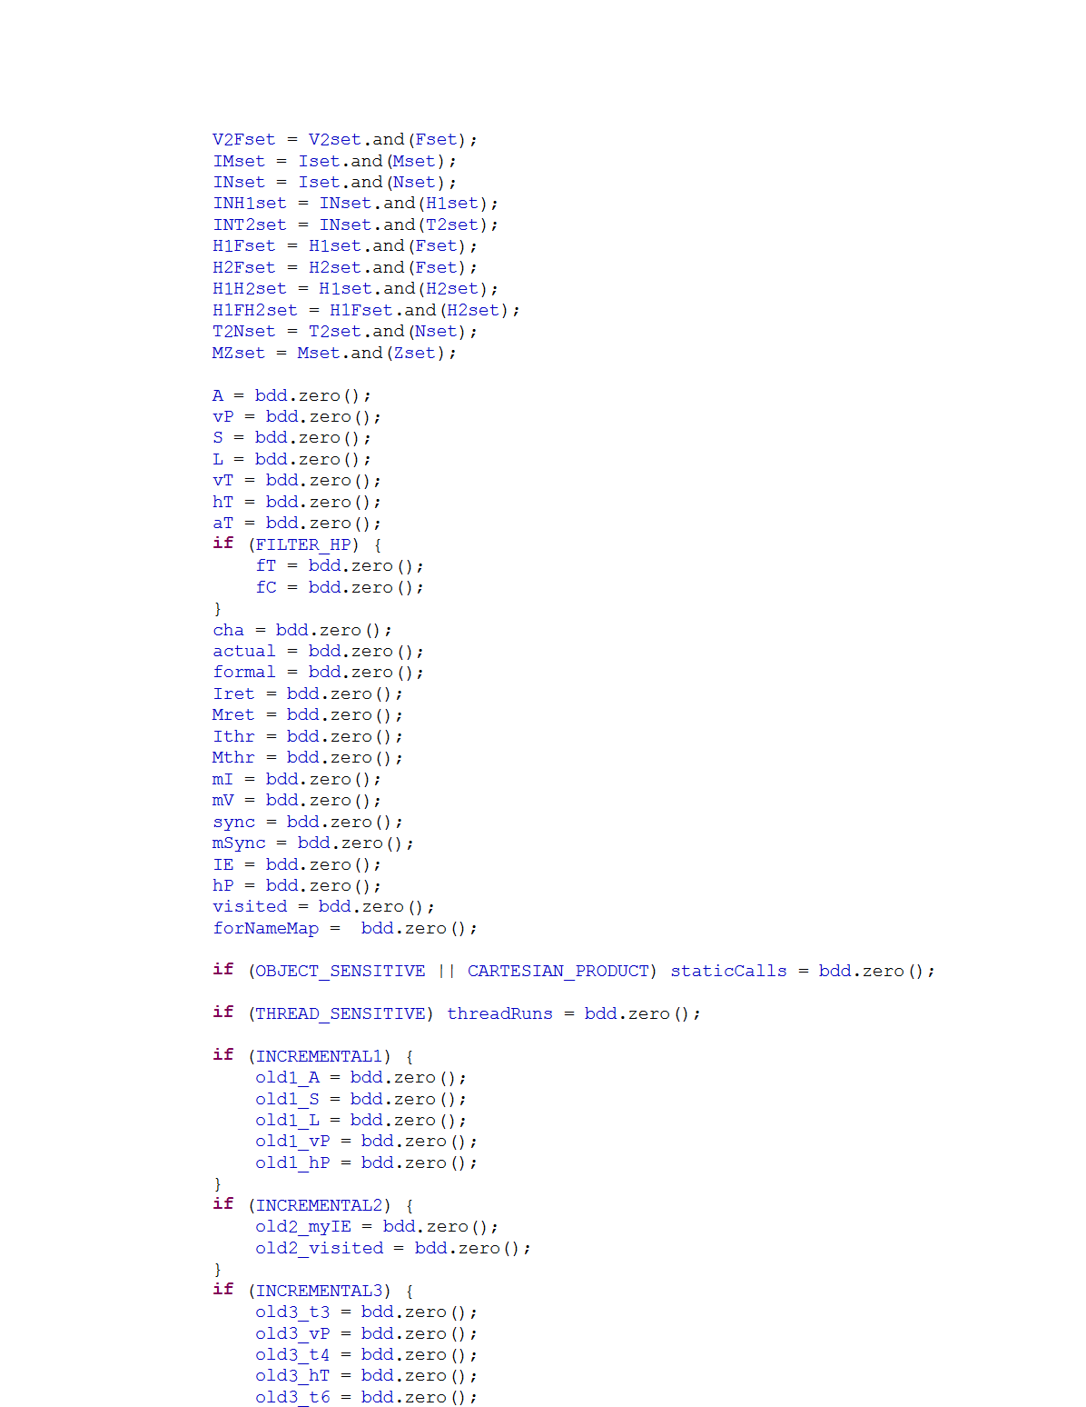
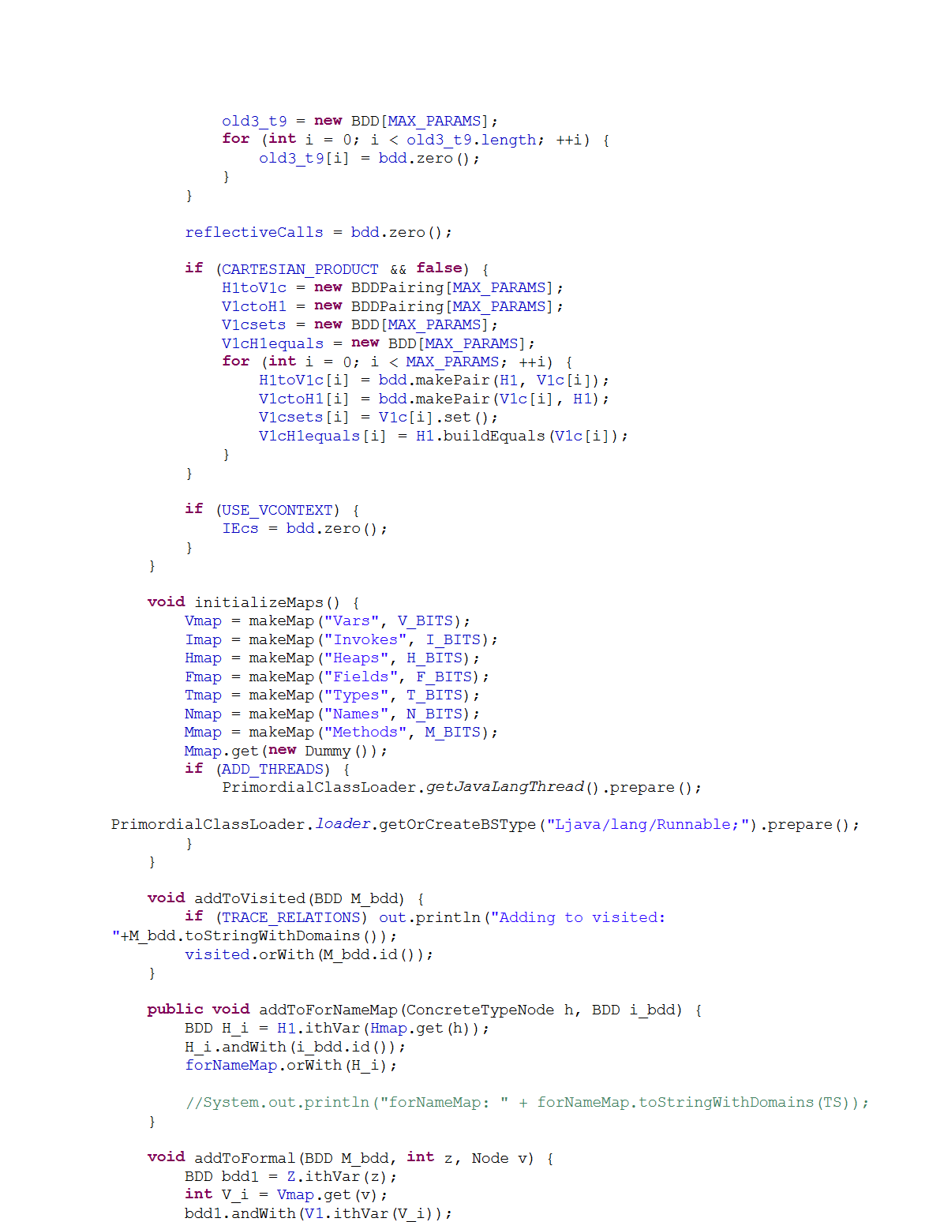
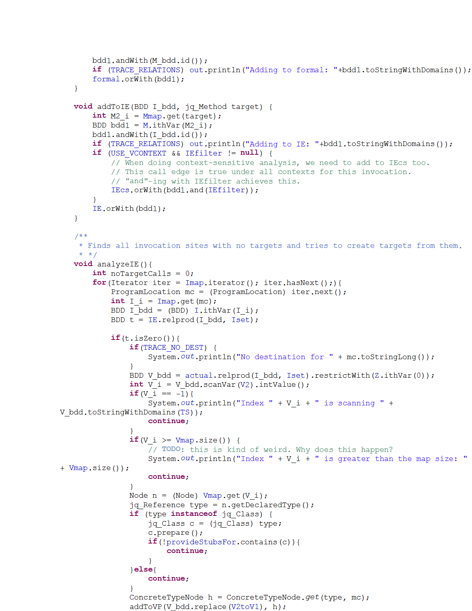
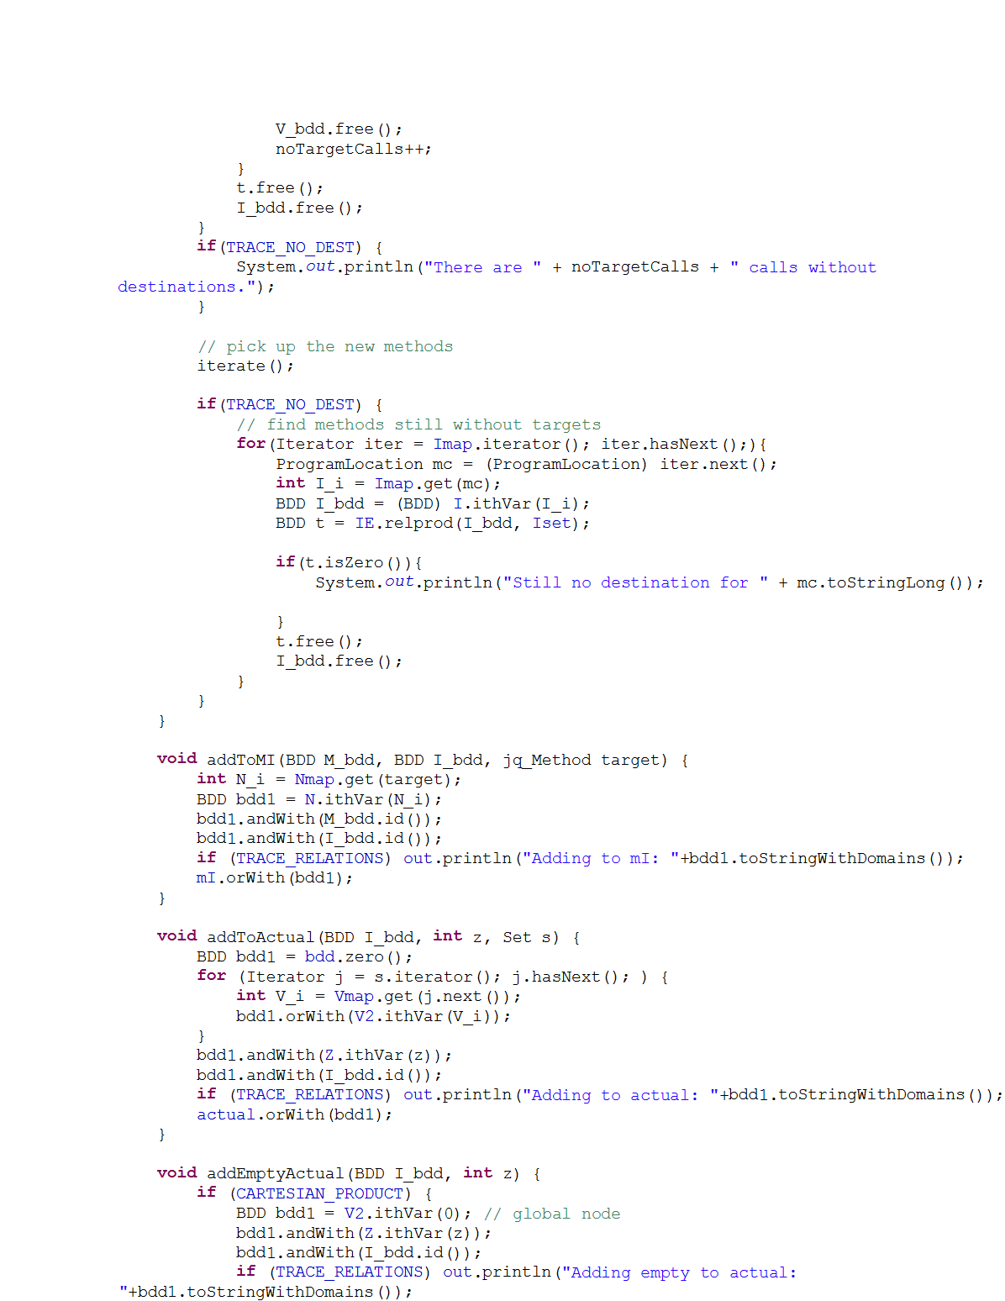
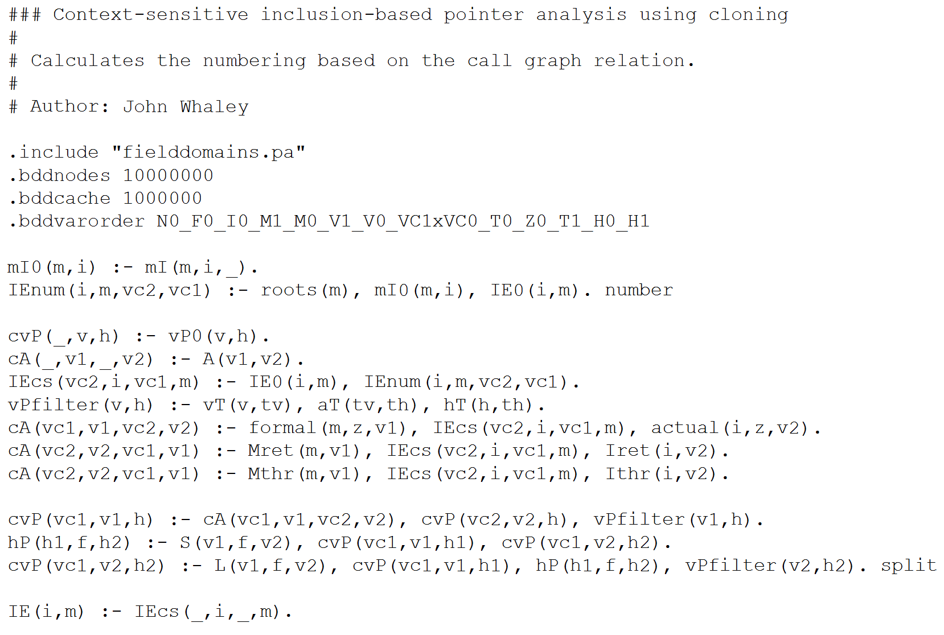
Implementing Program Analysis
vs.
2x faster
Fewer bugs
Extensible
…56 pages!
Notes:
I’m going to give you the punchline at the beginning of the talk, so if you find it boring, you can escape now.

Slide 3
Outline
Introduction
Program Analysis in Datalog
  Example of Pointer Analysis
Binary Decision Diagrams (BDDs)
Datalog to Efficient BDDs
Experimental Results
Conclusion

Slide 4
Program Analysis in Datalog

Slide 5
Datalog
Declarative language for deductive databases [Ullman 1989]
  Like Prolog, but no function symbols,
  no predefined evaluation strategy
Semantics of negation
  No negation allowed [Ullman 1988]
  Stratified Datalog [Chandra 1985]
  Well-founded semantics [Van Gelder 1991]
Evaluation strategy
  Top-down (goal-directed) [Ullman 1985]
  Bottom-up (infer from base facts) [Ullman 1989]
Additional restriction: finite domains
Notes:
This slide is to satisfy all of the logic programming freaks out there.
Datalog dates back to around 1978 when Herve Gallaire and Jack Minker organized a workshop on logic and databases.
Bottom-up is better suited for set-oriented operations. ‘subsumption test’ in semi-naïve evaluation is not a problem with BDDs.

Slide 6
Flow-Insensitive
Pointer Analysis
o₁: p = new Object();
o₂: q = new Object();
p.f = q;
r = p.f;
Input Tuples
vPointsTo(p, o₁)
vPointsTo(q, o₂)
Store(p, f, q)
Load(p, f, r)
Output Relations
hPointsTo(o₁, f, o₂)
vPointsTo(r, o₂)
p
o₁
f
q
o₂
r

Slide 7
Inference Rule in Datalog
Assignments:
vPointsTo(v₁, o)
:- Assign(v₁, v₂),
vPointsTo(v₂, o).
v₁ = v₂;
v₂
o
v₁
Notes:
Now let me show you how we actually specify the algorithm. Here is the Datalog rule to handle assignment instructions.
Datalog looks like Prolog, but operates on a relation at a time. What it says is if everything on the right hand side is true, then the left hand side is also true.
What this rule says is this:
(Read slowly:)
© v1 points to h1 if there is an assignment instruction v1 = v2, and v2 points to h1.
That’s it. So this is just transitive closure. Let’s take a look at another rule.

Slide 8
Inference Rule in Datalog
Stores:
hPointsTo(o₁, f, o₂)
:- Store(v₁, f, v₂),
vPointsTo(v₁, o₁),
vPointsTo(v₂, o₂).
v₁.f = v₂;
v₁
o₁
f
v₂
o₂
Notes:
Here is the Datalog rule to handle store instructions.
What this rule says is:
(Read slowly:)
© H1.f points to h2 if there is a store instruction v1.f = v2, and v1 points to h1 and v2 points to h2.
With me so far? OK

Slide 9
Inference Rule in Datalog
Loads:
vPointsTo(v₂, o₂)
:- Load(v₁, f, v₂),
vPointsTo(v₁, o₁),
hPointsTo(o₁, f, o₂).
v₂ = v₁.f;
v₁
o₁
f
v₂
o₂
Notes:
Here is the Datalog rule to handle load instructions.
Very similar to the rule for store instructions.
What this rule says is this:
(Read slowly:)
© v2 points to h2 if there is a load instruction v2 = v1.f, and v1 points to h1 and h1.f points to h2.

Slide 10
The Whole Algorithm
vPointsTo(v, o)
:- vPointsTo₀(v, o).
vPointsTo(v₁, o)
:- Assign(v₁, v₂),
vPointsTo(v₂, o).
hPointsTo(o₁, f, o₂)
:- Store(v₁, f, v₂),
vPointsTo(v₁, o₁),
vPointsTo(v₂, o₂).
vPointsTo(v₂, o₂)
:- Load(v₁, f, v₂),
vPointsTo(v₁, o₁),
hPointsTo(o₁, f, o₂).
Notes:
So here’s the whole algorithm on one slide.
Looks easy, right? So you might ask, what's the big deal? It looks almost trivial. Well, I think this really shows off the power of our technique. Previous work on precise pointer analysis was just horribly complicated, because that was what was necessary to get an efficient algorithm. In the past, I myself was guilty of writing horribly complex pointer analysis papers. But when we use this system bddbddb, we can just write a few simple inference rules and let the system handle it. And, as I’ll show, the result is not only simpler, but also actually _more_ efficient.

Slide 11
Inference Rules
Assign(v₁, v₂), vPointsTo(v₂, o)
Assign(v₁, v₂), vPointsTo(v₂, o).
vPointsTo(v₁, o)
vPointsTo(v₁, o)
:-
Datalog rules directly correspond to inference rules!

Slide 12
Binary Decision Diagrams

Slide 13
Call graph relation
Call graph expressed as a relation.
  Five edges:
    Calls(A,B)
    Calls(A,C)
    Calls(A,D)
    Calls(B,D)
    Calls(C,D)
A
B
C
D
Notes:
We represent the edges in the call graph as a relation. We define a relation “Calls” with two attributes, the first is the caller and the second is the callee.
For example, for this call graph with four methods, A B C and D, there are five edges: AB, AC, AD, BD, and CD. So there are five tuples in the “Calls” relation, one for each edge in the call graph.

Slide 14
Call graph relation
Relation expressed as a binary function.
  A=00, B=01, C=10, D=11
→ 00 01
→ 00 10
→ 00 11
→ 01 11
→ 10 11
A
00
Calls(A,B)
Calls(A,C)
Calls(A,D)
Calls(B,D)
Calls(C,D)
01
B
C
10
D
11
Notes:
We can represent this relation as a binary function. We first label each node in the call graph with a binary number ©, so A is 00, B is 01, C is 10, and D is 11. We then use a function that equals one if the call graph edge exists, and zero if the edge doesn’t exist. Here is the truth table for the function that corresponds to the call graph relation. There are five ones corresponding to the five call graph edges, and the rest are zeroes.

Slide 15
Call graph relation
from |  | to
x₁ | x₂ | x₃ | x₄ | f
0 | 0 | 0 | 0 | 0
0 | 0 | 0 | 1 | 1
0 | 0 | 1 | 0 | 1
0 | 0 | 1 | 1 | 1
0 | 1 | 0 | 0 | 0
0 | 1 | 0 | 1 | 0
0 | 1 | 1 | 0 | 0
0 | 1 | 1 | 1 | 1
1 | 0 | 0 | 0 | 0
1 | 0 | 0 | 1 | 0
1 | 0 | 1 | 0 | 0
1 | 0 | 1 | 1 | 1
1 | 1 | 0 | 0 | 0
1 | 1 | 0 | 1 | 0
1 | 1 | 1 | 0 | 0
1 | 1 | 1 | 1 | 0
Relation expressed as a binary function.
  A=00, B=01, C=10, D=11
A
00
01
B
C
10
D
11
Notes:
We can represent this relation as a binary function. We first label each node in the call graph with a binary number ©, so A is 00, B is 01, C is 10, and D is 11. We then use a function that equals one if the call graph edge exists, and zero if the edge doesn’t exist. Here is the truth table for the function that corresponds to the call graph relation. There are five ones corresponding to the five call graph edges, and the rest are zeroes.

Slide 16
Binary Decision Diagrams (Bryant 1986)
Graphical encoding of a truth table.
x₁
0 edge
1 edge
x₂
x₂
x₃
x₃
x₃
x₃
x₄
x₄
x₄
x₄
x₄
x₄
x₄
x₄
0
1
1
1
0
0
0
1
0
0
0
1
0
0
0
0
Notes:
Binary decision diagrams are just a graphical encoding of a boolean function. Each node in the BDD is labeled with a variable. There are two kinds of edges, 0 edges and 1 edges. If the value of the variable at the node is zero, we follow the dotted zero edge, and if the value of the variable is one, we follow the solid one edge. We just copy the last column of the truth table into the bottom of the diagram, so again we have the five ones that correspond to our five call graph edges, and the rest are zero. These square nodes along the bottom are called “terminal nodes”, because they have no outgoing edges.

Slide 17
Binary Decision Diagrams
Collapse redundant nodes.
x₁
0 edge
1 edge
x₂
x₂
x₃
x₃
x₃
x₃
x₄
x₄
x₄
x₄
x₄
x₄
x₄
x₄
0
1
1
1
0
0
0
1
0
0
0
1
0
0
0
0
Notes:
Notice that there is a lot of redundancy in this diagram. Specifically, any node that has the same label and the same successors is redundant, and can be collapsed. So we can collapse all of the zero nodes and likewise all of the one nodes, like this.

Slide 18
Binary Decision Diagrams
Collapse redundant nodes.
x₁
0 edge
1 edge
x₂
x₂
x₃
x₃
x₃
x₃
x₄
x₄
x₄
x₄
x₄
x₄
x₄
x₄
0
1
Notes:
Now we can collapse some of the x4 nodes, like this.

Slide 19
Binary Decision Diagrams
Collapse redundant nodes.
x₁
0 edge
1 edge
x₂
x₂
x₃
x₃
x₃
x₃
x₄
x₄
x₄
0
1
Notes:
Also two of the x3 nodes, like this.

Slide 20
Binary Decision Diagrams
Collapse redundant nodes.
x₁
0 edge
1 edge
x₂
x₂
x₃
x₃
x₃
x₄
x₄
x₄
0
1
Notes:
Now we have a smaller diagram. Also, any node that has the same successor for both its zero edge and its one edge can be eliminated.

Slide 21
Binary Decision Diagrams
Eliminate unnecessary nodes.
x₁
0 edge
1 edge
x₂
x₂
x₃
x₃
x₃
x₄
x₄
x₄
0
1
Notes:
So these three nodes can be eliminated because they have the same zero and one edge successors.

Slide 22
Binary Decision Diagrams
Eliminate unnecessary nodes.
x₁
0 edge
1 edge
x₂
x₂
x₃
x₃
x₄
0
1
Notes:
Finally, we get this diagram, which is the reduced BDD for this function.

Slide 23
Binary Decision Diagrams
Size depends on amount of redundancy,
NOT size of relation.
  Identical subtrees share the same representation.
  As set gets very large, more nodes have identical zero and one successors, so the size decreases.
Notes:
One key point to notice is that the size of the BDD representation depends on the amount of redundancy in the relation, and NOT the number of elements in the relation.
If there is a lot of redundancy, then there will be lots of identical subtrees that get collapsed into a single copy.
Actually, as a set gets very large, the number of don’t-care bits actually increases, which leads to fewer necessary nodes. If you go to the extreme, the universal set in BDD is represented by one node: which is just the one terminal.

Slide 24
BDD Variable Order is Important!
x₁x₂ + x₃x₄
x₁
x₁
x₂
x₃
x₃
x₃
x₂
x₂
x₄
x₄
0
1
0
1
x₁<x₂<x₃<x₄
x₁<x₃<x₂<x₄

Slide 25
bddbddb
(BDD-based deductive database)

Slide 26

bddbddb System Overview
Java bytecode
Joeq frontend
Input relations
Datalog
program
Output relations

Slide 27
Datalog → BDDs
Datalog | BDDs
Relations | Boolean functions
Relation ops: ⋈, ∪, select, project | Boolean function ops: ∧, ∨, −, ∼
Relation at a time | Function at a time
Semi-naïve evaluation | Incrementalization
Fixed-point | Iterate until stable

Slide 28
Compiling Datalog to BDDs
Apply Datalog source level transforms.
Stratify and determine iteration order.
Translate into relational algebra IR.
Optimize IR and replace relational algebra ops with equivalent BDD ops.
Assign relation attributes to physical BDD domains.
Perform more optimizations after domain assignment.
Interpret the resulting program.
Notes:
Looks a lot like a compiler

Slide 29
High-Level Transform:
Magic Set Transformation
Add “magic” predicates to control generated tuples [Bancilhon 1986, Beeri 1987]
  Combines ideas from top-down and bottom-up evaluation
Doesn’t always help
  Leads to more iterations
  BDDs are good at large operations
Rely on user specification

Slide 30
Predicate Dependency Graph
vPointsTo₀
Load
Assign
Store
vPointsTo
add edge from RHS to LHS
hPointsTo
hPointsTo(o₁, f, o₂)
:- Store(v₁, f, v₂),
vPointsTo(v₁, o₁),
vPointsTo(v₂, o₂).
vPointsTo(v₂, o₂)
:- Load(v₁, f, v₂),
vPointsTo(v₁, o₁),
hPointsTo(o₁, f, o₂).
vPointsTo(v₁, o)
:- Assign(v₁, v₂),
vPointsTo(v₂, o).
vPointsTo(v, o)
:- vPointsTo₀(v, o).

Slide 31
Determining Iteration Order
Tradeoff between faster convergence and BDD cache locality
Static heuristic
  Visit rules in reverse post-order
  Iterate shorter loops before longer loops
Profile-directed feedback
User can control iteration order

Slide 32
Predicate Dependency Graph
vPointsTo₀
Load
Assign
Store
vPointsTo
hPointsTo

Slide 33
Datalog to Relational Algebra
vPointsTo(v₁, o)
:- Assign(v₁, v₂),
vPointsTo(v₂, o).
t₁ = ρ_{variable→source}(vPointsTo);
t₂ = assign ⋈ t₁;
t₃ = π_{source}(t₂);
t₄ = ρ_{dest→variable}(t₃);
vPointsTo = vPointsTo ∪ t₄;

Slide 34
Incrementalization
vP’’ = vP – vP’;
vP’ = vP;
assign’’ = assign – assign’;
assign’ = assign;
t₁ = ρ_{variable→source}(vP’’);
t₂ = assign ⋈ t₁;
t₅ = ρ_{variable→source}(vP);
t₆ = assign’’ ⋈ t₅;
t₇ = t₂ ∪ t₆;
t₃ = π_{source}(t₇);
t₄ = ρ_{dest→variable}(t₃);
vP = vP ∪ t₄;
t₁ = ρ_{variable→source}(vP);
t₂ = assign ⋈ t₁;
t₃ = π_{source}(t₂);
t₄ = ρ_{dest→variable}(t₃);
vP = vP ∪ t₄;

Slide 35
Optimize into BDD operations
vP’’ = vP – vP’;
vP’ = vP;
assign’’ = assign – assign’;
assign’ = assign;
t₁ = ρ_{variable→source}(vP’’);
t₂ = assign ⋈ t₁;
t₅ = ρ_{variable→source}(vP);
t₆ = assign’’ ⋈ t₅;
t₇ = t₂ ∪ t₆;
t₃ = π_{source}(t₇);
t₄ = ρ_{dest→variable}(t₃);
vP = vP ∪ t₄;
vP’’ = diff(vP, vP’);
vP’ = copy(vP);
t₁ = replace(vP’’,variable→source);
t₃ = relprod(t₁,assign,source);
t₄ = replace(t₃,dest→variable);
vP = or(vP, t₄);

Slide 36
Physical domain assignment
vP’’ = diff(vP, vP’);
vP’ = copy(vP);
t₁ = replace(vP’’,variable→source);
t₃ = relprod(t₁,assign,source);
t₄ = replace(t₃,dest→variable);
vP = or(vP, t₄);
vP’’ = diff(vP, vP’);
vP’ = copy(vP);
t₃ = relprod(vP’’,assign,V0);
t₄ = replace(t₃, V1→V0);
vP = or(vP, t₄);
Minimizing renames is NP-complete
Renames have vastly different costs
Priority-based assignment algorithm

Slide 37
Other optimizations
Dead code elimination
Constant propagation
Definition-use chaining
Redundancy elimination
Global value numbering
Copy propagation
Liveness analysis

Slide 38
Variable Numbering:
Active Machine Learning
Must be determined dynamically
Limit trials with properties of relations
Each trial may take a long time
Active learning:
select trials based on uncertainty
Several hours
Comparable to exhaustive for small apps

Slide 39
Experimental Results
Notes:
Now let me present some of the experimental results from our technique.
I’m going to present three kinds of results for the pointer analysis: time, memory, and accuracy.

Slide 40
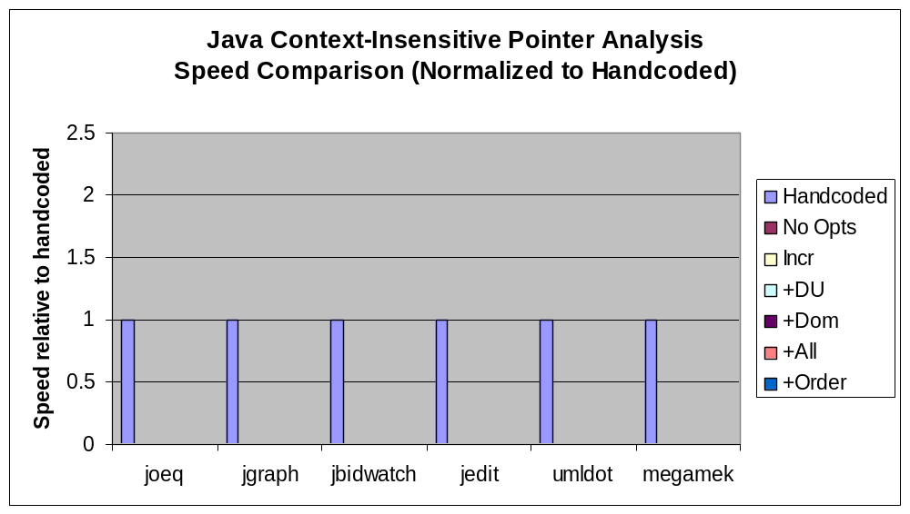
Experimental Results

Slide 41
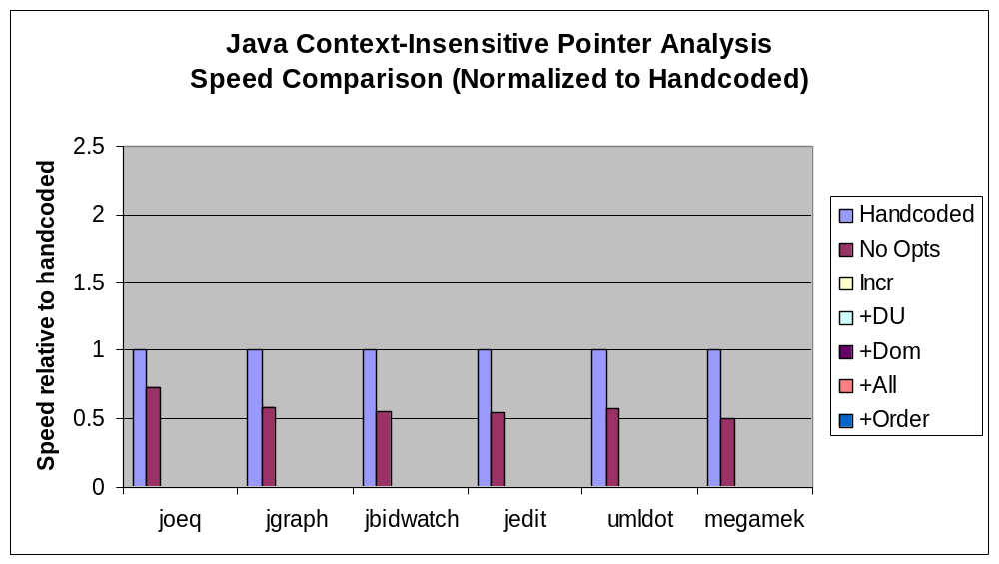
Experimental Results

Slide 42
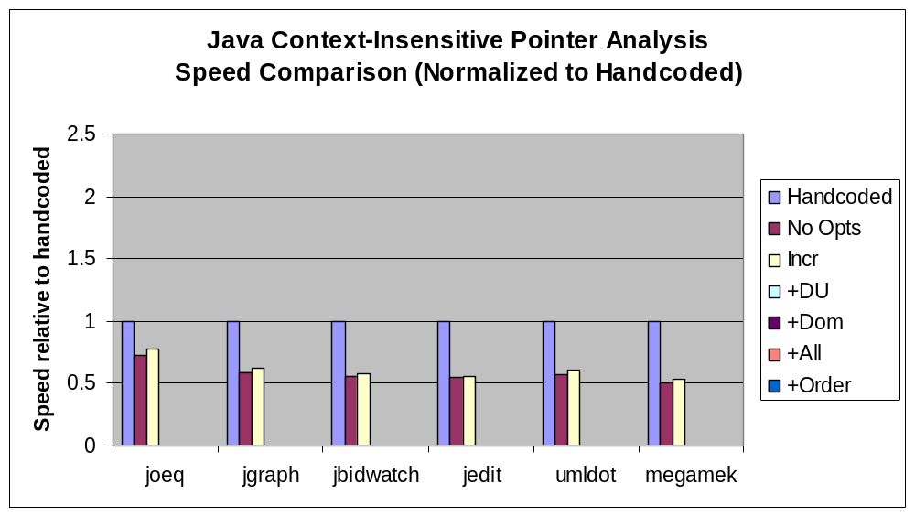
Experimental Results

Slide 43
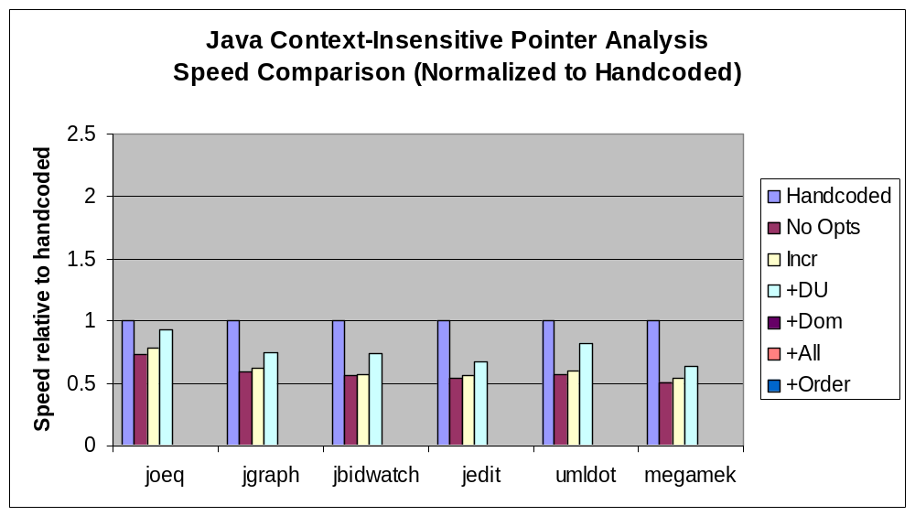
Experimental Results

Slide 44
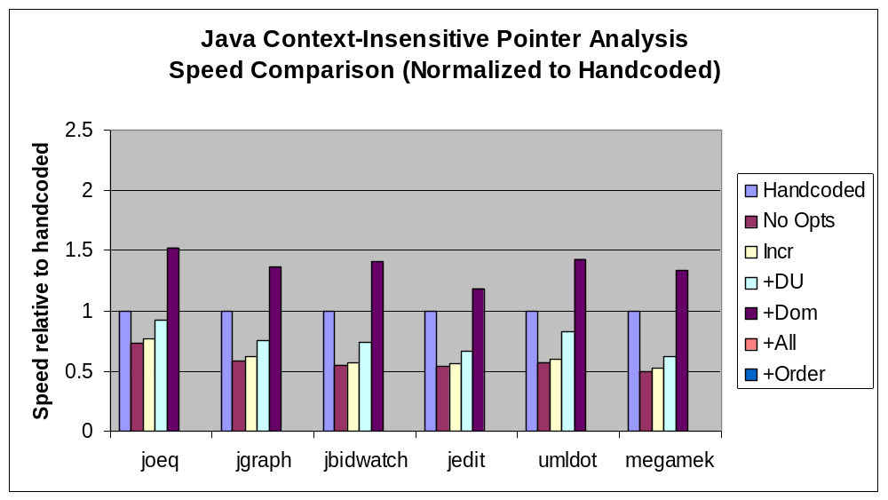
Experimental Results

Slide 45
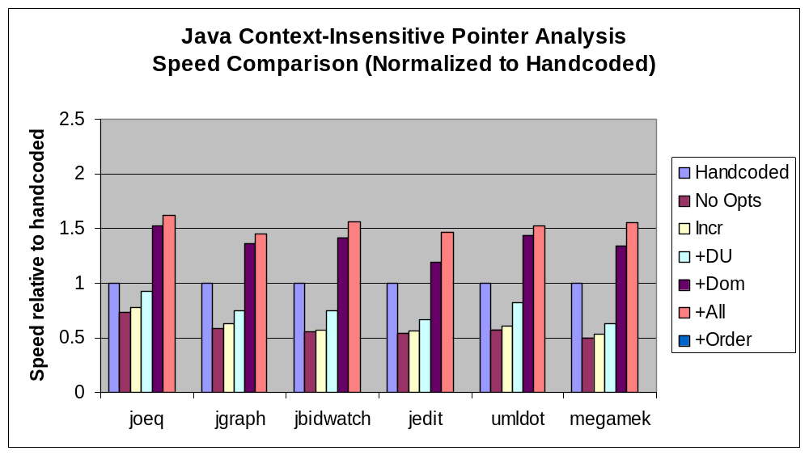
Experimental Results

Slide 46
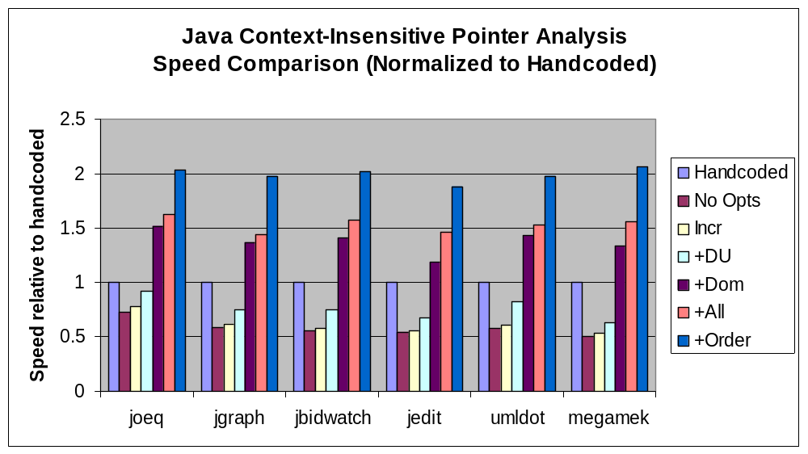
Experimental Results

Slide 47
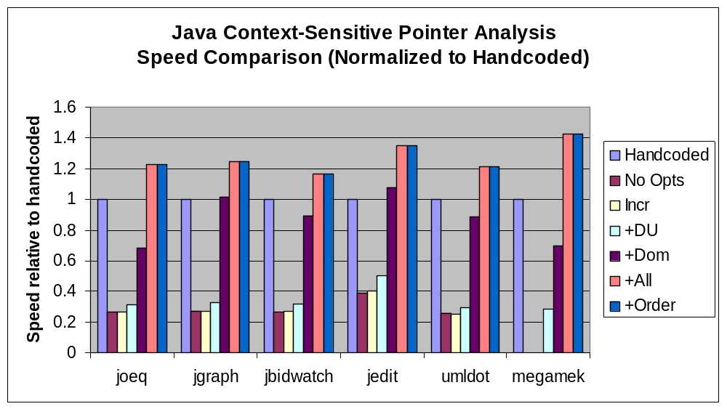
Experimental Results

Slide 48
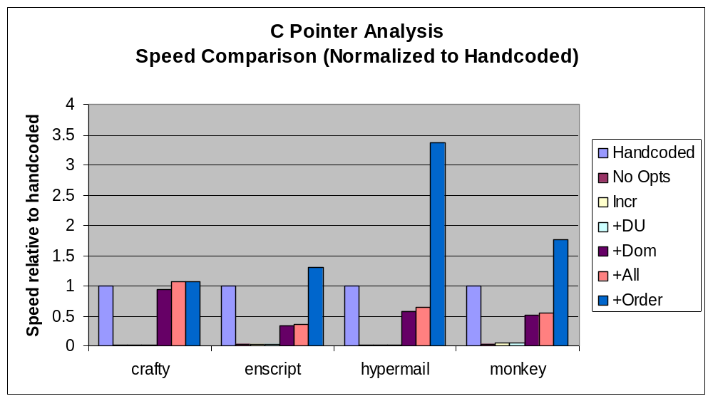
Experimental Results

Slide 49
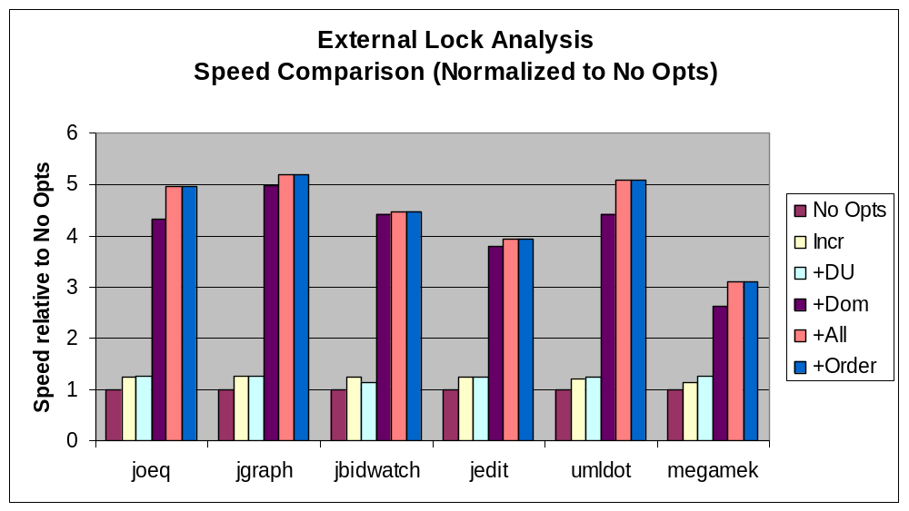
Experimental Results

Slide 50
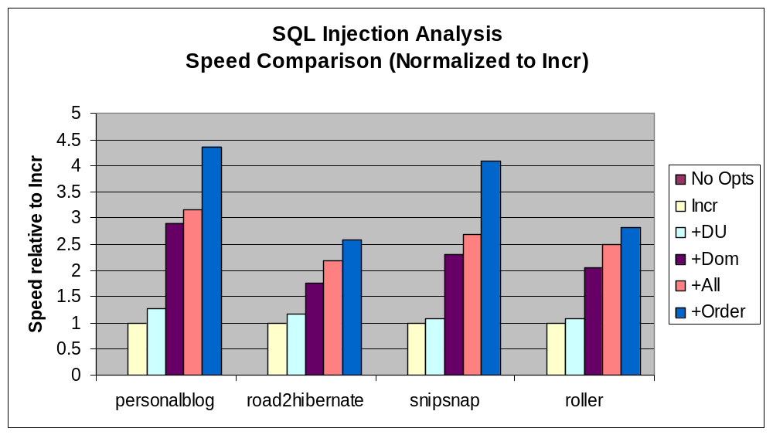
Experimental Results

Slide 51
Related Work
Datalog in Program Analysis
  Specify as Datalog query [Ullman 1989]
  Toupie system [Corsini 1993]
  Demand-driven using magic sets [Reps 1994]
  Program analysis with logic programming [Dawson 1996]
  Crocopat system [Beyer 2003]
  Modular class analysis [Besson 2003]
BDDs in Program Analysis
  Predicate abstraction [Ball 2000]
  Shape analysis [Manevich 2002, Yavuz-Kahveci 2002]
  Pointer Analysis [Zhu 2002, Berndl 2003, Zhu 2004]
  Jedd system [Lhotak 2004]
Notes:
Grumberg: HW verification
come to fruition

Slide 52
Related Work
BDD Variable Ordering
  Variable ordering is NP-complete [Bollig 1996]
  Interleaving [Fujii 1993]
  Sifting [Rudell 1993]
  Genetic algorithms [Drechsler 1995]
  Machine learning for BDD orders [Grumberg 2003]
Efficient Evaluation of Datalog
  Semi-naïve evaluation [Balbin 1987]
  Bottom-up evaluation [Ullman 1989, Ceri 1990, Naughton 1991]
  Top-down evaluation with tabling [Tamaki 1986, Chen 1996]
  Rule ordering [Ramakrishnan 1990]
  Magic sets transformation [Bancilhon 1986]
  Computing with BDDs [Iwaihara 1995]
  Time and space guarantees [Liu 2003]
Notes:
Active learning [Greiner 2002]

Slide 53
Program Analysis with bddbddb
Context-sensitive Java pointer analysis
C pointer analysis
Escape analysis
Type analysis
External lock analysis
Finding memory leaks
Interprocedural def-use
Interprocedural mod-ref
Object-sensitive analysis
Cartesian product algorithm
Resolving Java reflection
Bounds check elimination
Finding race conditions
Finding Java security vulnerabilities
And many more…
Performance better than handcoded!
Notes:
I and others have used bddbddb to develop a variety of program analyses, such as type analysis, escape analysis, side-effect analysis, and many more. Within six months of its release, one student used bddbddb to implement a context-sensitive pointer analysis for C, which is much more complicated than Java due to pointer arithmetic and lack of type safety. He used his C analysis to optimize away the bounds checks in a bounds-checking C implementation. Another student has used bddbddb and the pointer analysis to build a tool that identifies security vulnerabilities in Java applications.
People who have used bddbddb have told me how much easier it is to develop analyses and that they could never go back to the old way of doing program analysis.
My ultimate goal is to make Datalog for program analysis like SQL was for databases: An easy, uniform interface that anyone can use, but in the backend it uses very sophisticated and powerful techniques.

Slide 54
Conclusion
bddbddb: new paradigm in program analysis
  Datalog compiled into optimized BDD operations
  Efficiently and easily implement context-sensitive analyses
  Easier to develop correct analyses
  Easily experiment with new ideas
  Growing library of program analyses
  Easily use and build upon work of others
Available as open-source LGPL: http://bddbddb.sourceforge.net
Notes:
Not only can you take advantage of analyses that others have done and easily build upon their work, but it also allows others to take your work and build upon it and take it in new and interesting directions. In essence, bddbddb lowers the barriers to collaboration and community, by providing a standard platform with a very simple, compact, uniform way of formulating program analyses.
The ability to have some idea about program analysis and just write a few Datalog rules and have a working implementation that performs well is extremely intoxicating, and I don’t think I could ever go back to the old way.
So if you are interested in developing a constraint-style program analysis, I encourage you to take a look at bddbddb,

Slide 55
That’s all, folks!
Thanks for sticking around for all <number> slides!

Slide 56
My Contribution (2)
bddbddb
(BDD-based deductive database)
  Pointer analysis in 6 lines of Datalog
  (a database language)
    Hard to create & debug efficient BDD-based algorithms (3451 lines, 1 man-year)
    Automatic optimizations in bddbddb
  Easy to create context-sensitive analyses using pointer analysis results (a few lines)
  Created many analyses using bddbddb
Notes:
those inference rules into an efficient implementation. So my second contribution is a system called "bddbddb", which stands for "BDD-Based Deductive DataBase“. In bddbddb, we represent the entire program as relations in a database. We then use Datalog, which is a database language, to specify program analyses. The context-sensitive pointer analysis is just six lines of Datalog. Contrast this with the handcoded version of the algorithm, which was thousands of lines of code and took 1 man-year to build and debug. bddbddb performs many optimizations automatically, which means you can just give it your analysis written in Datalog and it will automatically generate a very efficient implementation. Plus, because we represent everything in a simple uniform way, it is easy to create context-sensitive analyses that use the pointer analysis results. I and others have created many analyses using bddbddb, and the experience has been overwhelmingly positive.

Slide 57
Outline
Pointer Analysis
  Problem Overview
  Brief History
  Pointer Analysis in Datalog
Context Sensitivity
Improving Performance
bddbddb: BDD-based deductive database
Experimental Results
  Analysis Time
  Analysis Memory
  Analysis Accuracy
Conclusion

Slide 58
Performance is Tricky!
Context-sensitive numbering scheme
  Modify BDD library to add special operations.
  Can’t even analyze small programs. Time: ∞
Improved variable ordering
  Group similar BDD variables together.
  Interleave equivalence relations.
  Move common subsets to edges of variable order. Time: 40h
Incrementalize outermost loop
  Very tricky, many bugs. Time: 36h
Factor away control flow, assignments
  Reduces number of variables. Time: 32h

Slide 59
Performance is Tricky!
Exhaustive search for best BDD order
  Limit search space by not considering intradomain orderings. Time: 10h
Eliminate expensive rename operations
  When rename changes relative order, result is not isomorphic. Time: 7h
Improved BDD memory layout
  Preallocate to guarantee contiguous. Time: 6h
BDD operation cache tuning
  Too small: redo work, too big: bad locality
  Parameter sweep to find best values. Time: 2h

Slide 60
Performance is Tricky!
Simplified treatment of exceptions
  Reduce number of variables, iterations necessary for convergence. Time: 1h
Change iteration order
  Required redoing much of the code. Time: 48m
Eliminate redundant operations
  Introduced subtle bugs. Time: 45m
Specialized caches for different operations
  Different caches for and, or, etc. Time: 41m

Slide 61
Performance is Tricky!
Compacted BDD nodes
  20 bytes → 16 bytes Time: 38m
Improved BDD hashing function
  Simpler hash function. Time: 37m
Total development time: 1 year
  1 year per analysis?!?
Optimizations obscured the algorithm.
Many bugs discovered, maybe still more.

Slide 62
bddbddb:
BDD-Based Deductive DataBase
Automatically generate from Datalog
  Optimizations based on my experience with handcoded version.
  Plus traditional compiler algorithms.
bddbddb even better than handcoded!
  handcoded: 37m bddbddb: 19m
Notes:
I do the dirty work, so you don’t have to!

Slide 63
Java Security Vulnerabilities
Application |  | Reported Errors |  | Actual
Name | Classes | context-insensitive | context-sensitive | Errors
blueblog | 306 | 1 | 1 | 1
webgoat | 349 | 81 | 6 | 6
blojsom | 428 | 48 | 2 | 2
personalblog | 611 | 350 | 2 | 2
snipsnap | 653 | >321 | 27 | 15
road2hiberna | 867 | 15 | 1 | 1
pebble | 889 | 427 | 1 | 1
roller | 989 | >267 | 1 | 1
Total | 5356 | >1508 | 41 | 29
due to V. Benjamin Livshits

Slide 64
Vulnerabilities Found
 | SQL injection | HTTP splitting | Cross-site scripting | Path traversal | Total
Header | 0 | 6 | 4 | 0 | 10
Parameter | 6 | 5 | 0 | 2 | 13
Cookie | 1 | 0 | 0 | 0 | 1
Non-Web | 2 | 0 | 0 | 3 | 5
Total | 9 | 11 | 4 | 5 | 29

Slide 65
Summary of Contributions
The first scalable context-sensitive subset-based pointer analysis.
  Cloning-based technique using BDDs
  Clever context numbering
  Experimental results on the effects of context sensitivity
bddbddb: new paradigm in program analysis
  Efficiently and easily implement context-sensitive analyses
  Datalog compiled into optimized BDD operations
  Library of program analyses (with many others)
  Active learning for BDD variable orders (with M. Carbin)
Artifacts:
  Joeq compiler and virtual machine
  JavaBDD library and BuDDy library
  bddbddb tool

Slide 66
Looking Forward
Program analysis for the masses
  Integrate into software development process
  Programmers, domain-specialists specify their own “patterns”
Important work still to come
  Technology issues
  User-interface issues
  Programmer culture issues

Slide 67
Conclusion
The first scalable context-sensitive subset-based pointer analysis.
  Accurate: Results for up to 10¹⁴ contexts.
  Scales to large programs.
bddbddb: a new paradigm in prog analysis
  High-level spec → Efficient implementation
System is publicly available at:
http://bddbddb.sourceforge.net

